Slide 1
Process

Slide 2
Introduction
Early computers allowed only one program to be executed at a time.
This program had complete control of the system and had access to system resources.
In contrast, contemporary computer systems allow multiple programs to be loaded into memory and executed simultaneously.
This resulted in the notion of a process, which is a program in execution.

Slide 3
Process Concept
A time shared system has user programs or tasks.
Even on a single-user system, a user may be able to run several programs at one time: a word processor, a web browser and an email package.
The above all are processes.

Slide 4
The Process
A process is a program in execution.
But it is more than program code (text section).
It also includes current activity as represented by the value of the program counter, process-id and the contents of the CPU registers.
A process generally includes,
Process stack(contains temporary data - function parameters, return addresses and local variables)
Data section (contains global variables)
Heap (for dynamically allocated memory)

Slide 5
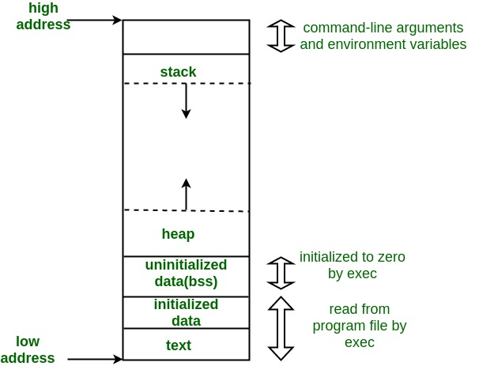
Memory Layout of C Programs
A typical memory representation of C program consists of following sections
Text segment
Initialized data segment
Uninitialized data segment
Stack
Heap

Slide 6
Memory Layout of C Programs
The GNU size command can be used to determine the size (in bytes) of some of these sections.
Assuming the name of the executable file of the above C program is memory, the following is the output generated by entering the command size memory:
text data bss dec hex filename
1158 284 8 1450 5aa memory
The data field refers to uninitialized data, and bss refers to initialized data. (bss is a historical term referring to block started by symbol.)
The dec and hex values are the sum of the three sections represented in decimal and hexadecimal, respectively.

Slide 7
The Process
A program by itself is not a process.
A program is a passive entity, such as a file containing a list of instructions stored on a disk (often an exe file).
A process is an active entity with a program counter specifying the next instruction to execute and a set of associated resources.
A program becomes a process when an exe file is loaded into memory.
Eg: double clicking pgm.exe (or) typing ./a.out in command prompt

Slide 8
The Process
Although two processes may be associated with same program, they are nevertheless two separate execution sequences.
Eg:
Several users running same copy of the mail program.
(or)
The same user may invoke many copies of the web browser program.
Each of these is a separate process and although the text sections are equivalent, the data, heap and stack segments vary.

Slide 9
Process Control Block (PCB)
Each process is represented in the OS by a PCB.
It contains many pieces of information associated with a specific process.
PCB contains sufficient information so that it is possible to interrupt a running process and later resume execution.
It enables OS to support multiple processes.

Slide 10
Process Control Block (PCB)
Information associated with each process.
Process identifier
Process state
Program counter
CPU registers
CPU scheduling information
Memory-management information
Accounting information
I/O status information

Slide 11
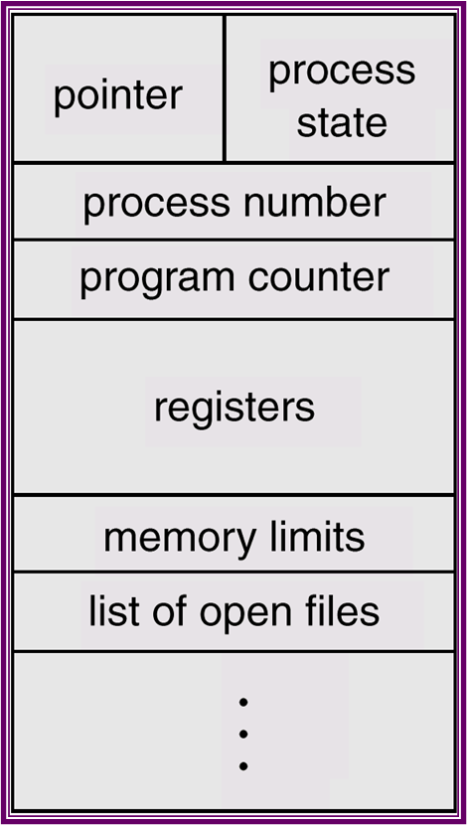
Process Control Block (PCB)

Slide 12
Process State
As a process executes, it changes state.
The state of a process is defined in part by the current activity of that process.
A process may be in any one of the following states.
new: The process is being created.
running: Instructions are being executed.
waiting/blocked: The process is waiting for some event to occur.
ready: The process is waiting to be assigned to a processor.
terminated: The process has finished execution.

Slide 13
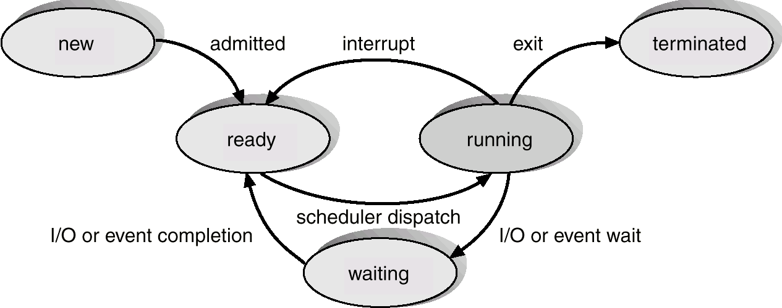
Five State Process Model
Only one process can be running an any processor at any instant.
Many processes can be ready and waiting

Slide 14
State transitions
Null->new
A new process is created to execute a program
New->ready
The OS will move process from new to ready when it is prepared to take on additional process. There is a limit on number of processes in main memory
Ready->running
When it is time to select a process to run, the OS chooses one of the processes in ready state. Done by scheduler or dispatcher.
Running->exit
Currently running process terminated by OS, if the process indicates that it has completed or if it aborts.

Slide 15
State transitions
Running -> ready
The most common reason for this transition is that the running processes has reached the max allowable time or some other high priority process has come in for execution
Running->Blocked
A process is put to blocked state if it requests for OS services like an I/O operation, or resource.
Blocked->ready
When the event for which the process has been waiting occurs this transition happens
Ready->exit/Blocked->exit
A parent process may terminate a child process at any time. Also if parent terminates all child processes associated with parent may also terminate.

Slide 16
Suspended Processes
Processor is faster than I/O devices, so many processes could be waiting for I/O
Swap these processes to disk to free up more memory and use processor on more processes
Blocked/waiting state becomes suspend state when swapped to disk
Notes:
Mention that the aim is to fully utilize the processor.

Slide 17
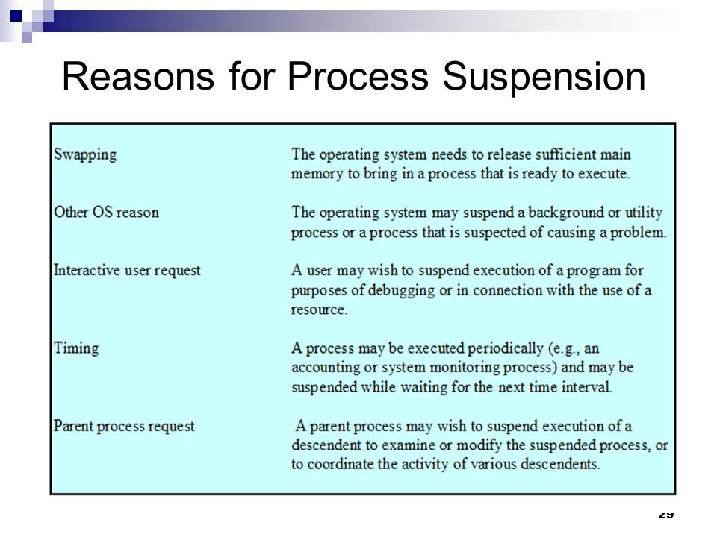

Slide 18
Process States during Suspension
One new state
Blocked
or
Two new states
Blocked/Suspend
Ready/Suspend

Slide 19
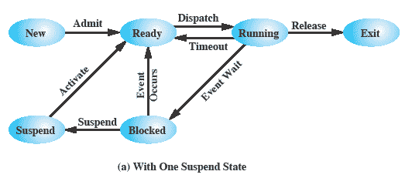
One Suspend State
Notes:
Again, the simple solution is to add a single state – but this only allows processes which are blocked to be swapped out.

Slide 20
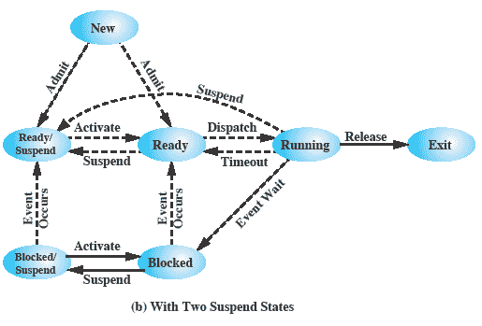
Two Suspend States - Seven State Process Model
Notes:
Two suspend states allow all processes which are not actually running to be swapped.
Run through the four states:
Ready: The process is in main memory and available for execution.
• Blocked: The process is in main memory and awaiting an event.
• Blocked/Suspend: The process is in secondary memory and awaiting an event.
• Ready/Suspend: The process is in secondary memory but is available for execution as soon as it is loaded into main memory.
It would be useful to also summarise the main transitions (abridged)
Blocked → Blocked/Suspend: If there are no ready processes, then at least one blocked process is swapped out to make room for another process that is not blocked. This transition can be made even if there are ready processes available, if the OS determines that the currently running process or a ready process that it would like to dispatch requires more main memory to maintain adequate performance.
Blocked/Suspend → Ready/Suspend: A process in the Blocked/Suspend state is moved to the Ready/Suspend state when the event for which it has been waiting occurs.
Ready/Suspend S → Ready: When there are no ready processes in main memory, or if a suspended process has a higher priority, the OS will need to bring one in to continue execution.
Ready → Ready/Suspend: Normally, the OS would prefer to suspend a blocked process rather than a ready one, because the ready process can now be executed, whereas the blocked process is taking up main memory space and cannot be executed. However, it may be necessary to suspend a ready process if that is the only way to free up a sufficiently large block of main memory.
Several other transitions that are worth considering are the following:
New → Ready/Suspend and New →Ready: When a new process is created, it can either be added to the Ready queue or the Ready/Suspend queue. In either case, the OS must create a process control block and allocate an address space to the process. It might be preferable for the OS to perform these housekeeping duties at an early time, so that it can maintain a large pool of processes that are not blocked. With this strategy, there would often be insufficient room in main memory for a new process; hence the use of the (New → Ready/Suspend) transition.
Blocked/Suspend → Blocked: Inclusion of this transition may seem to be poor design. After all, if a process is not ready to execute and is not already in main memory, what is the point of bringing it in? But consider the following scenario:
A process terminates, freeing up some main memory.
There is a process in the (Blocked/Suspend) queue with a higher priority than any of the processes in the (Ready/Suspend) queue and
the OS has reason to believe that the blocking event for that process will occur soon.
Under these circumstances, it would seem reasonable to bring a blocked process into main memory in preference to a ready process.
Running → Ready/Suspend: Normally, a running process is moved to the Ready state when its time allocation expires. If, however, the OS is pre-empting the process because a higher-priority process on the Blocked/Suspend queue has just become unblocked, the OS could move the running process directly to the (Ready/Suspend) queue and free some main memory.
Any State → Exit: Typically, a process terminates while it is running, either because it has completed or because of some fatal fault condition. However, in some operating systems, a process may be terminated by the process that created it or when the parent process is itself terminated. If this is allowed, then a process in any state can be moved to the Exit state.

Slide 21
Additional process states
Blocked/Suspend : the process in secondary memory and awaiting an event
Ready/ Suspend: the process in secondary storage but is available for execution as soon as it is loaded in memory

Slide 22
New State transitions
Blocked ->blocked/suspend
If there are no ready processes, then at least one blocked process is swapped out to secondary storage to make space for another process which is not blocked.
Blocked/suspend ->ready/suspend
This transition happens when the event for which the process has been waiting for occurs
Ready/suspend->ready
When no ready processes in memory, the OS will need to bring one in to continue execution or process in ready/suspend state has high priority than ready state processes.
Ready->ready suspend
Usually OS will suspend a blocked process to suspend state. But it may be necessary to suspend a ready process if that is the only way to free large block of main memory or blocked process may be high priority process than ready process

Slide 23
Other transitions to consider
New->ready/suspend and new ->ready
When a new process is created it can be added either to ready state or ready suspend state based on the availability of main memory.
Blocked/Suspend->Blocked
It would be reasonable to bring a blocked process into main memory if it is a high priority process than any other process in ready suspend state and the OS has reason to believe that the blocking event for the process will occur soon.
Running ->ready/suspend
OS can pre-empt a running process and move it to ready suspend state directly because a blocked suspended high priority process has just become unblocked.
Any state ->exit
A process get terminated while running, due to its completion or fatal error conditions. Sometimes if a parent process terminates, the child processes associated with the parent process can also terminate, whatever may be the state the child process are in.

Slide 24
New State of a Process
A new state corresponds to a process that has just been defined.
An identifier is associated with the process.
Any tables needed to manage the process are allocated and built.
At this stage the process is in new state.
While a process is in the new state, information concerning the process that is needed by the OS is maintained in control tables in main memory.
When the process is in new state, the code of the program is not in main memory and no space has been allocated for the data associated with the program.
The program remains in secondary storage.

Slide 25
Reasons for Process Creation
When a new process is to be added to those currently being managed, the OS builds the data structures that are used to manage the process and allocates address space in main memory to the process.

Slide 26
Process Creation
Process spawning
when the OS creates a process at the explicit request of another process
Parent process
is the original, creating, process
Child process
is the new process
Notes:
As another example,
a server process (e.g., print server, file server) may generate a new process for each
request that it handles. When the OS creates a process at the explicit request of
another process, the action is referred to as process spawning .
When one process spawns another, the former is referred to as the parent
process , and the spawned process is referred to as the child process . Typically, the
“related” processes need to communicate and cooperate with each other. Achieving
this cooperation is a difficult task for the programmer; this topic is discussed in
Chapter 5 .

Slide 27
Process Creation
During the course of execution, a process may create several new processes.
The creating process is called a parent process, and the new processes are called the children of that process.
Each of these new processes may in turn create other processes, forming a tree of processes.
Most operating systems (including UNIX, Linux, and Windows) identify processes according to a unique process identifier (or pid), which is typically an integer number.
The pid provides a unique value for each process in the system, and it can be used as an index to access various attributes of a process within the kernel.

Slide 28
Process Creation
The above figure illustrates a typical process tree for the Linux operating system, showing the name of each process and its pid.

Slide 29
Process Creation
The systemd process (which always has a pid of 1) serves as the root parent process for all user processes, and is the first user process created when the system boots.
Once the system has booted, the systemd process creates processes which provide additional services such as a web or print server, an ssh server, and the like.
Two children of systemd—logind and sshd.
The logind process is responsible for managing clients that directly log onto the system.
In this example, a client has logged on and is using the bash shell, which has been assigned pid 8416.
Using the bash command-line interface, this user has created the process ps as well as the vim editor.
The sshd process is responsible for managing clients that connect to the system by using ssh (which is short for secure shell).

Slide 30
Process Creation
Traditional UNIX systems identify the process init as the root of all child processes.
init (also known as System V init) is assigned a pid of 1, and is the first process created when the system is booted.
On a process tree similar to what is shown in previous figure, init is at the root.
Linux systems initially adopted the System V init approach, but recent distributions have replaced it with systemd.
systemd serves as the system’s initial process, much the same as System V init; however it is much more flexible, and can provide more services, than init.

Slide 31
Process Creation
On UNIX and Linux systems, we can obtain a listing of processes by using the ps command.
For example, the command
ps -el
will list complete information for all processes currently active in the system.
When a process creates a new process, two possibilities for execution exist:
The parent continues to execute concurrently with its children.
The parent waits until some or all of its children have terminated.
There are also two address-space possibilities for the new process:
The child process is a duplicate of the parent process (it has the same program and data as the parent - text segment is common for both process, data segment of parent duplicated(copied) for child process).
The child process has a new program loaded into it.

Slide 32
C Program - Process Creation & Termination
#include <stdio.h>
#include <unistd.h>
#include <stdlib.h>
#include <sys/wait.h>
int main()
{
int forkresult;
printf("Parent now going to fork a child... \n");
forkresult=fork();
if(forkresult==-1)
{
printf("Fork failed\n");
exit(0);
}

Slide 33
C Program - Process Creation & Termination
else if(forkresult!=0)
{
printf("Parent waits for child to execute ls then parent executes pwd.\n");
wait(NULL);
execlp("pwd","pwd",NULL);
printf("This line gets printed when the above exec statement pwd fails\n");
}
else
{
printf("Child : I'm now going to execute ls!\n\n\n");
execlp ("ls", "ls", NULL);
printf ("Child prints %d: AAAAH ! ! My EXEC failed ! ! ! !\n", getpid());
exit(1);
}
}

Slide 34
Terminate State of a Process
A process exits a system in following stages.
When it reaches a natural completion point
When it aborts due to an unrecoverable error
When another process with the appropriate authority causes the process to abort.
Termination moves the process to the exit state, and the process is no longer eligible for execution.
The tables and other information associated with the process are temporarily preserved by the OS, for the auxiliary programs, to extract any needed information.
Once these processes has extracted the needed information, the OS no longer needs to maintain any data relating to the process, as it is deleted from the system.

Slide 35
Reasons for Process Termination

Slide 36
Process Termination
When a process terminates, its resources are deallocated by the operating system.
However, its entry in the process table must remain there until the parent calls wait(), because the process table contains the process’s exit status.
A process that has terminated, but whose parent has not yet called wait(), is known as a zombie process.
All processes transition to this state when they terminate, but generally they exist as zombies only briefly.
Once the parent calls wait(), the process identifier of the zombie process and its entry in the process table are released.

Slide 37
Process Termination
Now consider what would happen if a parent did not invoke wait() and instead terminated, thereby leaving its child processes as orphan processes.
Traditional UNIX systems addressed this scenario by assigning the init process as the new parent to orphan processes.
The init process periodically invokes wait(), thereby allowing the exit status of any orphaned process to be collected and releasing the orphan’s process identifier and process-table entry.
Although most Linux systems have replaced init with systemd, the latter process can still serve the same role, although Linux also allows processes other than systemd to inherit orphan processes and manage their termination.

Slide 38
Process Description

Slide 39
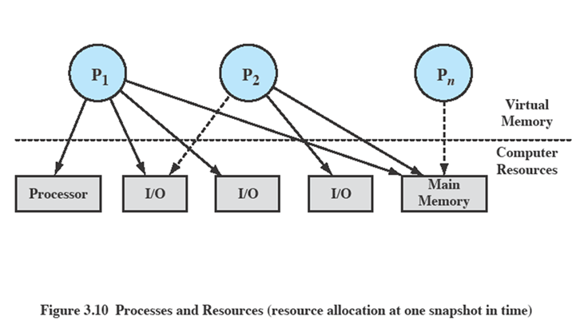
Process Description
The OS controls events within the computer system. It schedules and dispatches processes for execution by the processor, allocates resources to processes, and responds to requests by user processes for basic services.
Fundamentally, we can think of the OS as that entity that manages the use of system resources by processes.

Slide 40
Process Description
In above figure
There are a number of processes (P1, . . ., Pn,) that have been created and exist in virtual memory.
Each process, during the course of its execution, needs access to certain system resources, including the processor, I/O devices, and main memory.
In the figure, process P1 is running; at least part of the process is in main memory, and it has control of two I/O devices.
Process P2 is also in main memory but is blocked waiting for an I/O device allocated to P1.
Process Pn has been swapped out and is therefore suspended.

Slide 41
Operating System Control Structures
For the OS is to manage processes and resources, it must have information about the current status of each process and resource.
Tables are constructed for each entity the operating system manages

Slide 42
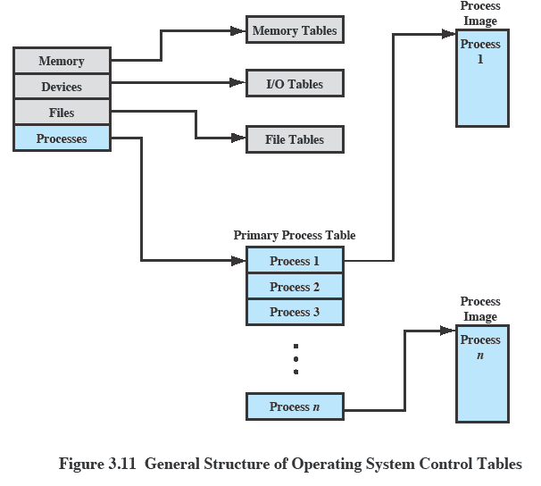
OS Control Tables

Slide 43
OS Control Tables
A general idea of the scope of the tables is in Figure, which shows four different types of tables maintained by the OS:
memory,
I/O,
file,
process.
Although the details will differ from one OS to another, fundamentally, all operating systems maintain information in these four categories.

Slide 44
Memory Tables
Memory tables are used to keep track of both main and secondary memory.
Must include this information:
Allocation of main memory to processes
Allocation of secondary memory to processes
Protection attributes for access to shared memory regions
Information needed to manage virtual memory
Memory tables are used to keep track of allocation of both main (real) and secondary (virtual) memory to processes.
Some of main memory is reserved for use by the OS; the remainder is available for use by processes.
Processes are maintained on secondary memory using some sort of virtual memory or simple swapping mechanism.

Slide 45
I/O Tables
Used by the OS to manage the I/O devices of the computer.
The OS needs to know
Whether the I/O device is available or assigned
The status of I/O operation
The location in main memory being used as the source or destination of the I/O transfer

Slide 46
File Tables
The OS may also maintain file tables.
These tables provide information about:
Existence of files
Location on secondary memory
Current Status
other attributes.
Sometimes this information is maintained by a file management system, in which case the OS has little or no knowledge of files.
In other operating systems, much of the detail of file management is managed by the OS itself.

Slide 47
Process Tables
To manage processes the OS needs to know details of the processes
Current state
Process ID
Location in memory
etc
Process control block
Process image is the collection of program, Data, stack, and attributes(PCB)
Memory, I/O, and files are managed on behalf of processes, so there must be some reference to these resources, directly or indirectly, in the process tables.
The files referred to in the file tables are accessible via an I/O device and will, at some times, be in main or virtual memory.
The tables themselves must be accessible by the OS and therefore are subject to memory management.

Slide 48
Process Control Structures
For the OS to manage and control a process, it must know:
Where the process is located
The attributes of the process like process id, process state…

Slide 49
Process Location
Each process has a number of attributes used by OS for process control.
These collection of attributes referred to a Process Control Block
The collection of program, data, stack and attributes(PCB) can be referred to as Process Image.

Slide 50
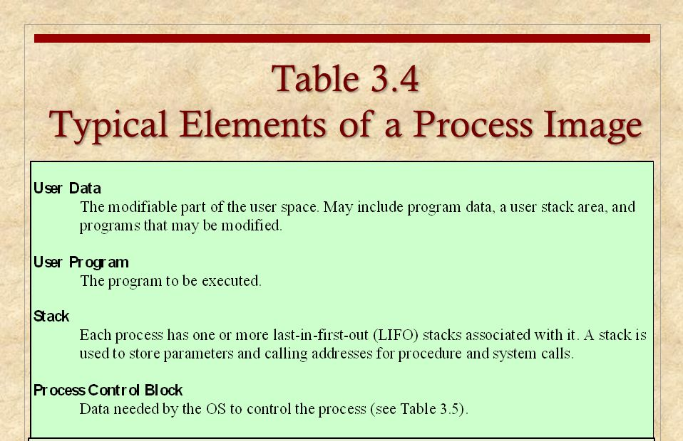

Slide 51
Process Location
For the OS to manage process, at least a small portion of its image must be loaded into main memory or at least virtual memory and OS must know the location of each process.
Therefore process tables maintained by the OS must show the location of the entire process image.
Each entry contains at least a pointer to a process image.

Slide 52
Process Attributes
A sophisticated multiprogramming system requires a great deal of information about each process.
Different systems will organize this information in different ways.
For now, let us simply explore the type of information that might be of use to an OS without considering in any detail how that information is organized.
We can group the process control block information into three general categories:
Process identification
Processor state information
Process control information

Slide 53
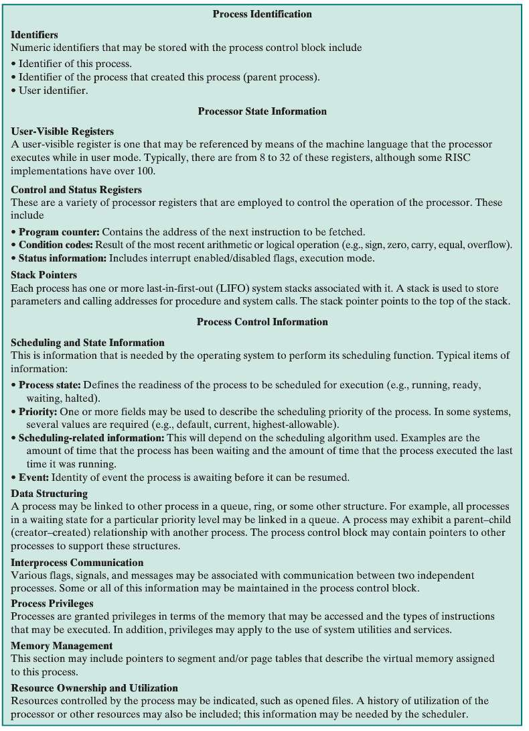
Typical Elements of Process Control Block

Slide 54
Process Identification
Each process is assigned a unique numeric identifier.
Many of the other tables controlled by the OS may use process identifiers to cross-reference process tables
In virtually all operating systems, each process is assigned a unique numeric identifier, which may simply be an index into the primary process table; otherwise there must be a mapping that allows the OS to locate the appropriate tables based on the process identifier.

Slide 55
Process Identification
For example,
The memory tables may be organized so as to provide a map of main memory with an indication of which process is assigned to each region.
Similar references will appear in I/O and file tables.
When processes communicate with one another, the process identifier informs the OS of the destination of a particular communication.
When processes are allowed to create other processes, identifiers indicate the parent and descendants of each process.
In addition to these process identifiers, a process may be assigned a user identifier that indicates the user responsible for the job.

Slide 56
Processor State Information
This consists of the contents of processor registers.
User-visible registers
Control and status registers
Stack pointers
Program status word (PSW)
contains status information
Example: the EFLAGS register on Pentium processors

Slide 57
Processor State Information
Processor state information consists of the contents of processor registers.
While a process is running, the information is in the registers.
When a process is interrupted, all of this register information must be saved so that it can be restored when the process resumes execution. Nature and number of registers vary by processor design
Typically, the register set will include user-visible registers, control and status registers, and stack pointers.

Slide 58
Process Control Information
This is the additional information needed by the OS to control and coordinate the various active processes.

Slide 59
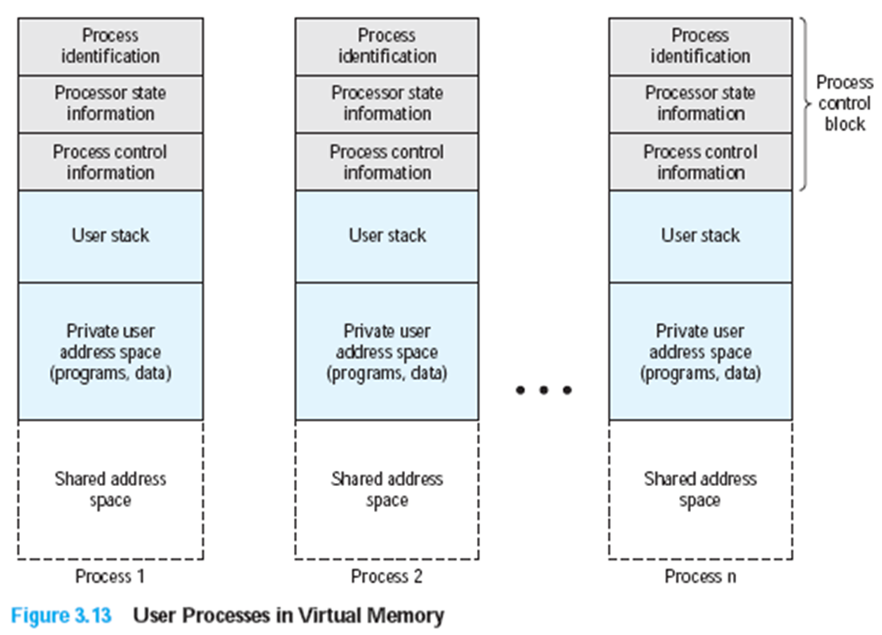
Structure of Process Images in Virtual Memory

Slide 60
Structure of Process Images in Virtual Memory
The above figure suggests the structure of process images in virtual memory.
Each process image consists of a process control block, a user stack, the private address space of the process, and any other address space that the process shares with other processes.
In the figure, each process image appears as a continuous range of addresses.
In actual implementation, this may not be the case, it may depend on the memory management scheme and the way in which control structures are organized by the OS.

Slide 61
Role of the Process Control Block
The process control block is the most important data structure in an OS.
Each process control block contains all of the information about a process that is needed by the OS.
The blocks are read and/or modified by virtually every module in the OS, including those involved with scheduling, resource allocation, interrupt processing, and performance monitoring and analysis.
Hence Process Control Block requires protection due to the below two problems:
A faulty routine could cause damage to the PCB destroying the OS’s ability to manage the process
Any design change to the PCB could affect many modules of the OS

Slide 62
Process Control

Slide 63
Process Control – Modes of Execution
The less-privileged mode is often referred to as the user mode, because user programs typically would execute in this mode.
More-privileged mode is System Mode also known as
Control Mode
Kernel Mode
Protected Mode
Certain instructions can only be executed in the more-privileged mode.
Including reading or altering a control register, such as the program status word;
Primitive I/O instructions;
Instructions that relate to memory management.
In addition, certain regions of memory can only be accessed in the more-privileged mode.

Slide 64
Process Control – Modes of Execution
Functions typically found in the kernel of an OS

Slide 65
Process Control – Modes of Execution
How does the processor know in which mode it is to be executing? And how does it change?
Typically a flag (single bit) in the program status word (PSW). This bit is changed in response to certain events.
Typically, when a user makes a call to an operating system service or when an interrupt triggers execution of an operating system routine, the mode is set to the kernel mode and, upon return from the service to the user process, the mode is set to user mode.

Slide 66
Process Control – Process Creation
Once the OS decides to create a new process it can proceed as follows:
Assigns a unique process identifier
At this time, a new entry is added to the primary process table, which contains one entry per process
Allocates space for the process
This includes all elements of process image. The size of memory to be allocated can be assigned as default based on type of process, as per user request or the parent process can pass the needed values to the OS.
Initializes process control block
Process Identification portion
Processor State Information portion
Process Control Information portion

Slide 67
Process Control – Process Creation
Sets up appropriate linkages
If OS maintains each scheduling queue as linked list, then the new process must be put in the Ready or Ready/Suspend list
Creates or expand other data structures
The OS may maintain an accounting file on each process to be used subsequently for billing or performance assessment purposes.

Slide 68
Process/Context Switching and Mode Switching

Slide 69
Process Control – Process Switching
At some time, a running process is interrupted and the OS assigns another process to the Running state and turns control over to that process.
Several design issues are raised regarding process switching
What events trigger a process switch?
We must distinguish between mode switching and process switching.
What must the OS do to the various data structures under its control to achieve a process switch?

Slide 70
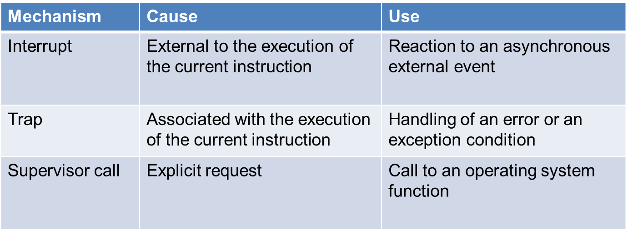
When to switch processes?
A process switch may occur any time that the OS has gained control from the currently running process. Possible events giving OS control are:

Slide 71
Process Control – Process Switching
Two kinds of system interrupts,
one is simply called an interrupt,
and the other called a trap.
“Interrupts” are due to some sort of event that is external to and independent of the currently running process, such as the completion of an I/O operation.
With an ordinary interrupt, control is first transferred to an interrupt handler, which does some basic housekeeping and then branches to an OS routine that is concerned with the particular type of interrupt that has occurred.
“Traps” relate to an error or exception condition generated within the currently running process, such as an illegal file access attempt.

Slide 72
Process Control – Process Switching
With traps, the OS determines if the error or exception condition is fatal.
If so, then the currently running process is moved to the Exit state and a process switch occurs.
If not, then the action of the OS will depend on the nature of the error and the design of the OS.
It may attempt some recovery procedure or simply notify the user.
It may do a process switch or resume the currently running process.
Finally, the OS may be activated by a supervisor call from the program being executed.
For example, a user process is running and an instruction is executed that requests an I/O operation, such as a file open.
This call results in a transfer to a routine that is part of the operating system code. The use of a system call may place the user process in the Blocked state.

Slide 73
Different Kinds of Interrupts
Clock Interrupt
The OS determines whether the currently running process has been executing for maximum allowable unit of time referred to as time slice. If so, this process must be switched to a ready state and another process dispatched.
I/O Interrupt
If the I/O operation completes for which one or more processes are waiting, then OS moves all those processes from blocked state to ready state. Then OS may continue with currently running process or schedule another high priority process that has been unblocked.

Slide 74
Different Kinds of Interrupts
Memory Fault
The processor encounters a virtual memory address reference for a word that is not in main memory. The OS must bring in the block of memory containing the reference from secondary memory to main memory.
After the I/O request is issued to bring in the block of memory, the process with the memory fault is placed in a blocked state; the OS then performs a process switch to resume execution of another process.
After the desired block is brought into memory, that process is placed in the Ready state.

Slide 75
Process Control – Mode Switching
In the interrupt stage, the processor checks for interrupt. If an interrupt is pending, the processor does the following:
It sets the program counter to the starting address of an interrupt handler program.
It switches from user to kernel mode so that the interrupt processing code may include privileged instructions.
The processor now proceeds to fetch stage and fetches the first instruction of the interrupt handler program, which will service the interrupt.
Now the context of the process that has been interrupted is saved into that PCB of the interrupted program.

Slide 76
Process Control – Mode Switching
What is the context of the process that gets saved when that interrupt occurs?
It must include any information that may be altered by the execution of the interrupt handler and that will be needed to resume the program that was interrupted.
Thus the portion of the PCB that was referred to as processor state information must be saved.
This includes the program counter, other processor registers and stack information.

Slide 77
Process Control – Mode Switching
In most operating systems, the occurrence of an interrupt does not necessarily mean a process switch.
It is possible that, after the interrupt handler has executed, the currently running process must resume execution.
In that case, all that is necessary is to save the processor state information when the interrupt occurs and restore the information when control is returned to the program that was running.
If the interrupt is to be followed by a switch to another process, then some work will need to be done.

Slide 78
Process Control – Change of Process State
A mode switch may occur without changing the state of the process that is currently in the running state.
In that case, the context saving and subsequent restoral involves little overhead.
If the currently running process is to be moved to another state (Ready, Blocked, etc.), then the OS must make substantial changes in its environment.

Slide 79
Process Control – Change of Process State
The steps in a process switch are:
Save context of processor including program counter and other registers
Update the process control block of the process that is currently in the Running state
Move process control block to appropriate queue – ready; blocked; ready/suspend
Select another process for execution
Update the process control block of the process selected
Update memory-management data structures
Restore context of the selected process
Thus the process switch, which involves a state change, requires more effort, than a mode switch

